Slide 1

Justice Diploma to Degree Pathways
JUSTICE DIPLOMA PATHWAYS

Slide 2
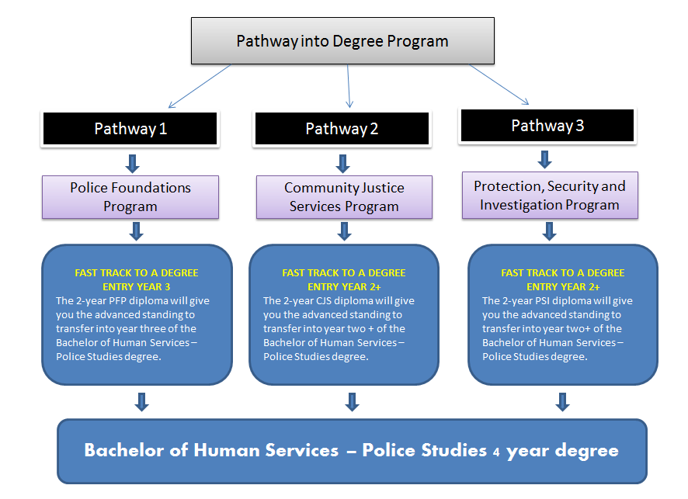


Slide 3
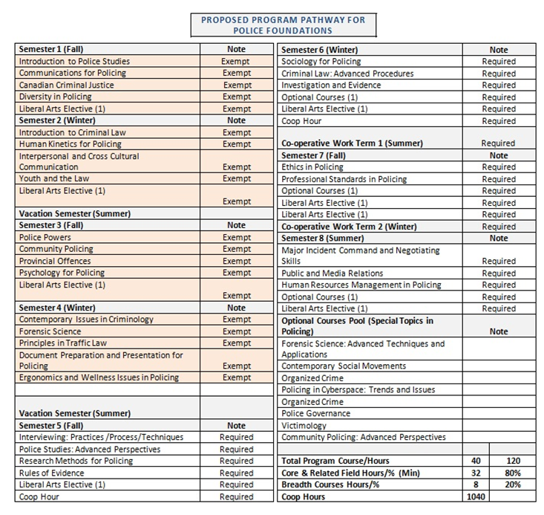
2 year PFP diploma = entry into Year 3 of BHSP [requiring 4 additional semesters plus co-op]
Students with a 70% average or higher will receive a block transfer of 20 credits. Under 70% average will be on a course by course basis.
PFPR
Notes:
Police Foundations programs are granted 20 exemptions based on meeting provincial program outcomes requiring 4 additional semesters plus co-op.

Slide 4
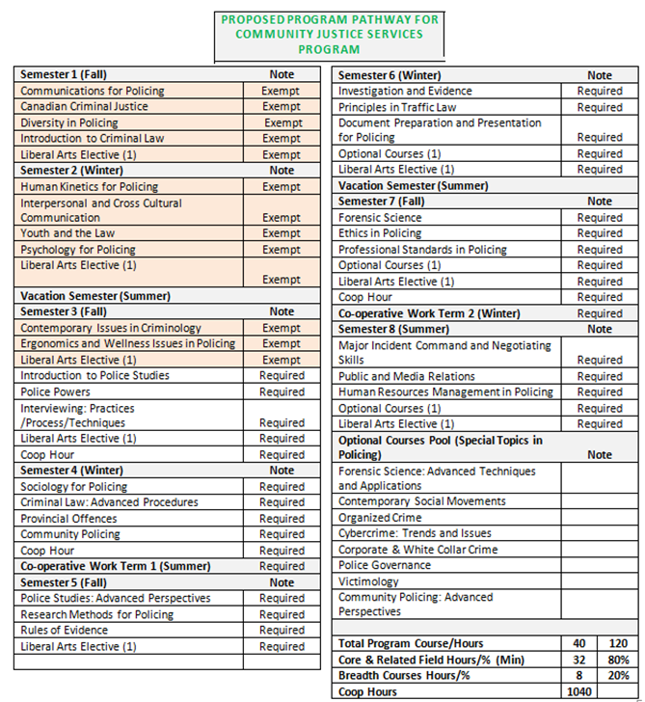
2 year CJSR diploma = entry into Year 2+ of BHSP [requiring 5.5 additional semesters plus co-op]
Students with a 70% average or higher will receive a block transfer of 13 credits. Under 70% average will be on a course by course basis.
CJSR
Notes:
Community Justice Services programs are granted 13 exemptions based on meeting provincial program outcomes requiring 5.5 additional semesters plus co-op.
2 year CJSR diploma = entry into Year 2+ of BHSP [requiring 5.5 additional semesters plus co-op]

Slide 5
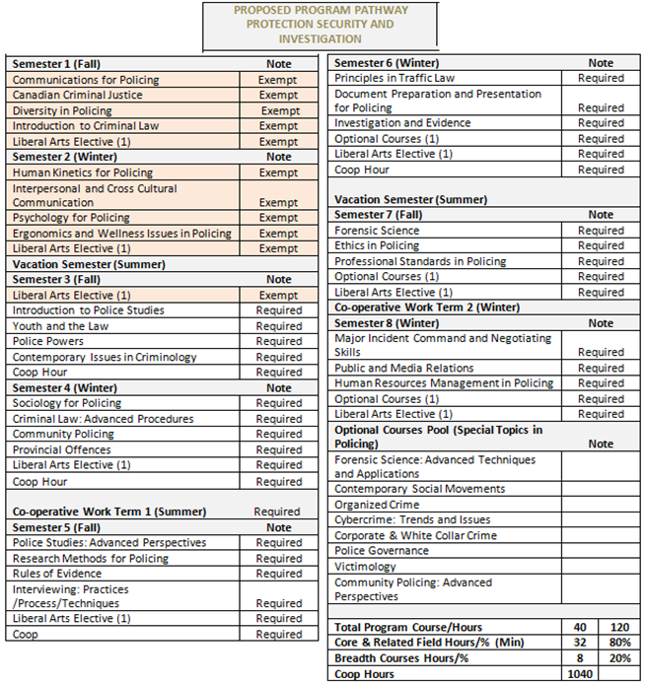
2 year PSIN diploma = entry into Year 2+ of BHSP [requiring 6 additional semesters plus co-op]
Students with a 70% average or higher will receive a block transfer of 11 credits. Under 70% average will be on a course by course basis.
CJSR
Notes:
Protection, Security and Investigation programs are granted 11 exemptions based on meeting provincial program outcomes requiring 6 additional semesters plus co-op.

